Slide 1

Parking lots automatization application

Slide 2
Design

Slide 3
TABLE OF CONTENTS
01
03
System Acquisition Strategy
Interfaces
02
04
Architecture
Programs
05
Databases

Slide 4
System Acquisition Strategy
01

Slide 5
We are going to use the Custom development in-house strategy for developing user and admin mobile applications using Flutter/Dart framework. However, we are going to use the Purchase software package strategy for attaching the application with a server using Firebase.
We are going to create a system which allows customers to keep track of the density of the parking lots, check in and check out the parking lot with a QR code system and keep track of payments which include monthly memberships. These functionalities are unique for the parking lot company.
Also, the development team has experience with the Flutter framework. However, Firebase is a prebuilt system which only requires creating and making connections with the application that we will develop. The team also has experience creating / connecting the database system using Firebase.
The project manager of the project is not highly skilled. However, for this project the methodology we are using is proven and the experience that the team has is enough to cover all the functionalities for developing the application.
The time to develop the application is not flexible. This is why we are using Firebase, which will enable us to focus on creating the mobile application on time.

Slide 6
Request for Proposal
We are going to create a system which allows them to keep track of the density of the parking lots, check in and check out the parking lot with a QR code system and keep track of payments which include monthly memberships for the parking lot company.
For this system, we need an admin mobile application for the company manager to use. Also, we need a user mobile application for the customers of the company. In order to make communications among these applications, we need an online database.
We are going to use the Flutter framework in order to develop these mobile applications. And we will use the Firebase as an online database system. By doing all these, the system will be ready to use.
The schedule for developing the applications is by 14th of June.

Slide 7
Alternative Matrix
Evaluation Criteria | Relative İmportance (Weight) | Alternative 1 | Score (1-5)* | Weighted Score | Alternative 2 | Score (1-5)* | Weighted Score
Technical Issues
Developing admin mobile application | 25 | Developing application using Flutter | 4 | 100 | Developing application using Java | 1 | 25
Developing user mobile application | 25 | Developing application using Flutter | 4 | 100 | Developing application using Java | 1 | 25
Developing Database | 25 | Using prebuilt database | 4 | 100 | Creating database from scratch | 1 | 25
Economic issues
Cost | 25 | Flutter is free and Firebase is free up to some limitation | 5 | 125 | Server costs $20 per year | 4 | 100
Total | 100 |  |  | 425 |  |  | 175
Since we have experience with flutter and firebase and using these costs nothing, it will be wise to move with the alternative 1 which has the highest score among all alternatives.
* This denotes how well the alternative meets the criteria. 1 = poor fit; 5 = perfect fit.

Slide 8
Architecture
02

Slide 9
In the parking lot automation system we will have client mobile devices which handle the presentation logic and application logic, and database management system (Firebase) server which will handle our data access logic and data storage.
Thus, Two-Tiered Client-Server architecture will be used. The client will be a Thick Client since most of the application logic will be on the client side.
We will not use any virtualization. We will use cloud computing for handling data access logic and data storage.
However, Firebase handles these computations for us, so that we will not be concerned about developing data access logic and data storage.

Slide 10
Operational Requirements
System Integration
The system will read and write the density information of the parking lots to the database.
The system will use the camera in order for the customers to check in and check out the parking lot with a QR code system. In addition, this information will be read and written to the database.
The system will read and write the payments of the customers.
Technical Environment
The development environment must have Flutter Framework installed.
The development environment should have a virtual emulator.
The development environment should have always-on network connection permitting real-time database updates.
Portability
The system must operate with Android and iOS mobile devices
Maintainability
The system should accommodate new membership types.
The system should accommodate new notification messages.

Slide 11
Performance Requirements
Capacity
Firebase has a free plan called Spark Plan.
Using this free plan, the system can handle a maximum of 100 active users at once.
Using this free plan, a maximum of 10GB data to be transferred within one month and store only a maximum of 1 GB of your data.
Speed
The network transaction response time should be less than 4 seconds. (Depending on the network speed of the user)
Availability and Reliability
The system should perform 99% uptime performance.

Slide 12
Security Requirements
Technical System Value Estimation
A complete loss of all system data would cost $10,000.
Access Control
The payments of all customers which include monthly memberships can be seen by only the managers of the parking lot company.
Check in and check out the parking lot with a QR code system should be made only by the customers of the parking lot company.
The payments of the user should be only seen by the user which made the payments.
Encryption and Authentication
Firestore automatically encrypts all data before it is written to disk. Also, the data is automatically and transparently decrypted when read by an authorized user.
Firebase Authentication provides backend services, easy-to-use SDKs to authenticate users to the application.
Virus Control
There will be no need for virus check since there are no files needed to upload to the database.

Slide 13
Cultural/Political Requirements
Multilingual
The system will operate in English and Turkish.
Customization
The managers can customize the notification messages that they are going to send.
Legal
The personal information of the customers cannot be transferred to any third party organizations.
Making Unstated Norms Explicit
All payments will be done in Turkish liras.
The admin and user mobile application will be developed with Flutter framework. Thus, the system will be able to run on the iOS device which has version 12 or more, and on the Android device which has the version of 5 or more.

Slide 14
Interfaces
03

Slide 15
Use Scenario: Check in into the parking lot
User wants to park his/her car into the parking lot by using the QR code system.
If a user does not have an account he/she needs to sign up to the system (1.1). If the user has an account already, users should login before using the system (1.2).
After signup or login, users should tab the QR code screen on the application in order to enter the parking lot (2.3).
Use Scenario: Check out from the parking lot
User wants to leave the parking lot by using the QR code system.
Users should be already signed up to the system in order to park their cars into the parking lot. However, they need to login before using the system (1.2).
After login, users should tab the QR code screen on the application in order to leave the parking lot (2.3).
After system response, the user should be able to see the payment details from the payment details screen (2.2).
Use Scenario: Monitor the density of parking lots live
User wants to Monitor the density of the parking lots live.
If a user does not have an account he/she needs to sign up to the system (1.1). If the user has an account already, users should login before using the system (1.2).
After signup or login, users should tab the Live Density screen on the application in order to monitor the density information of the parking lots (2.1).

Slide 16
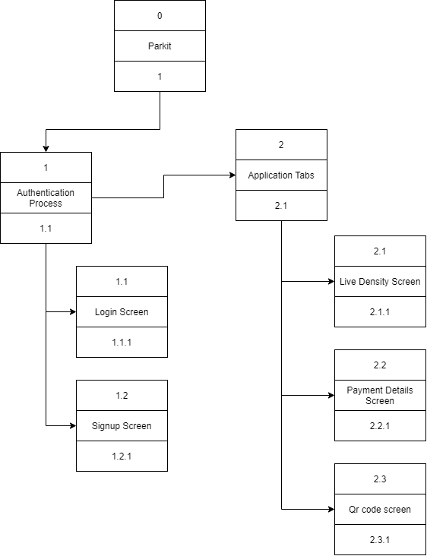
Interface Structure Diagram

Slide 17
Interface Standards
The interface metaphor is the QR code system in order to check in and check out to the parking lot. This is the core idea of the system to automate the parking lot entrance system.
In order to have a terminology that fits the users’ expectations consistently, the interface objects and actions names are chosen carefully. For example, “Density” is chosen for the intensity of the parking lots.
For the interface Icons, the Flutter’s icon package will be used in order to reach the standards within the icons. Also, the icons will be chosen with the best match of the word.

Slide 18
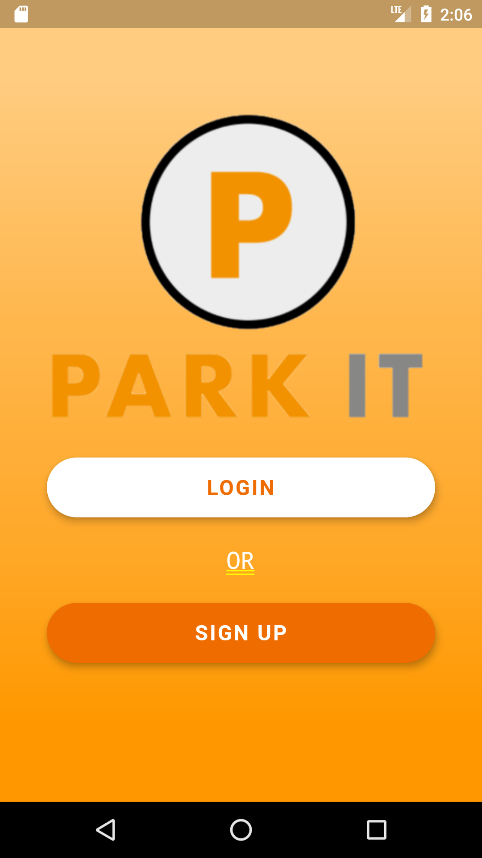
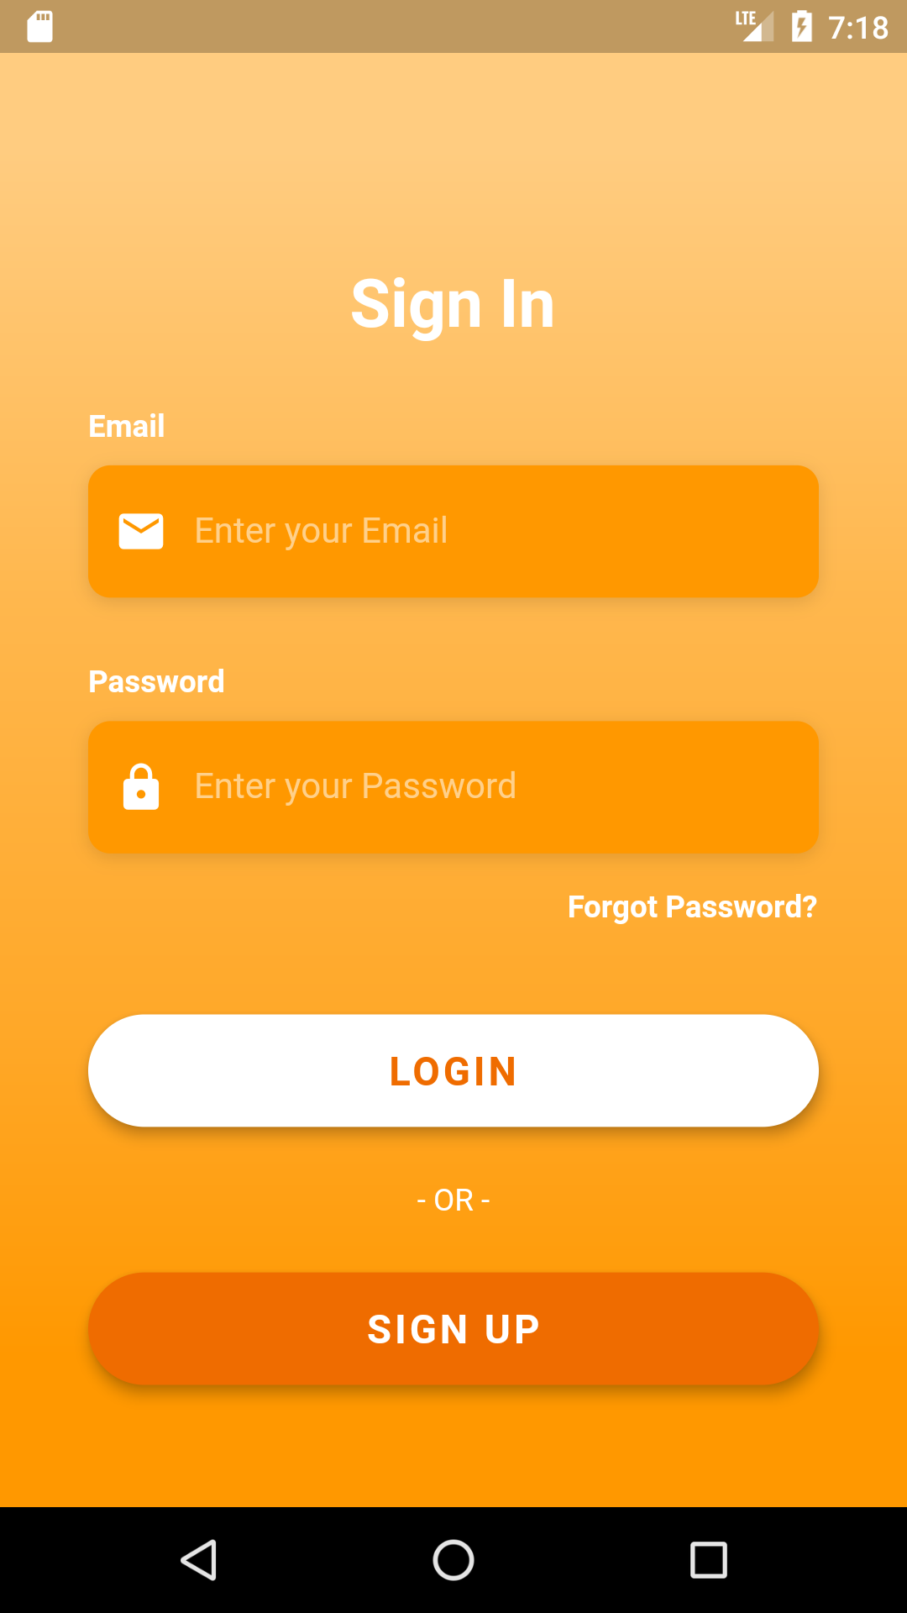
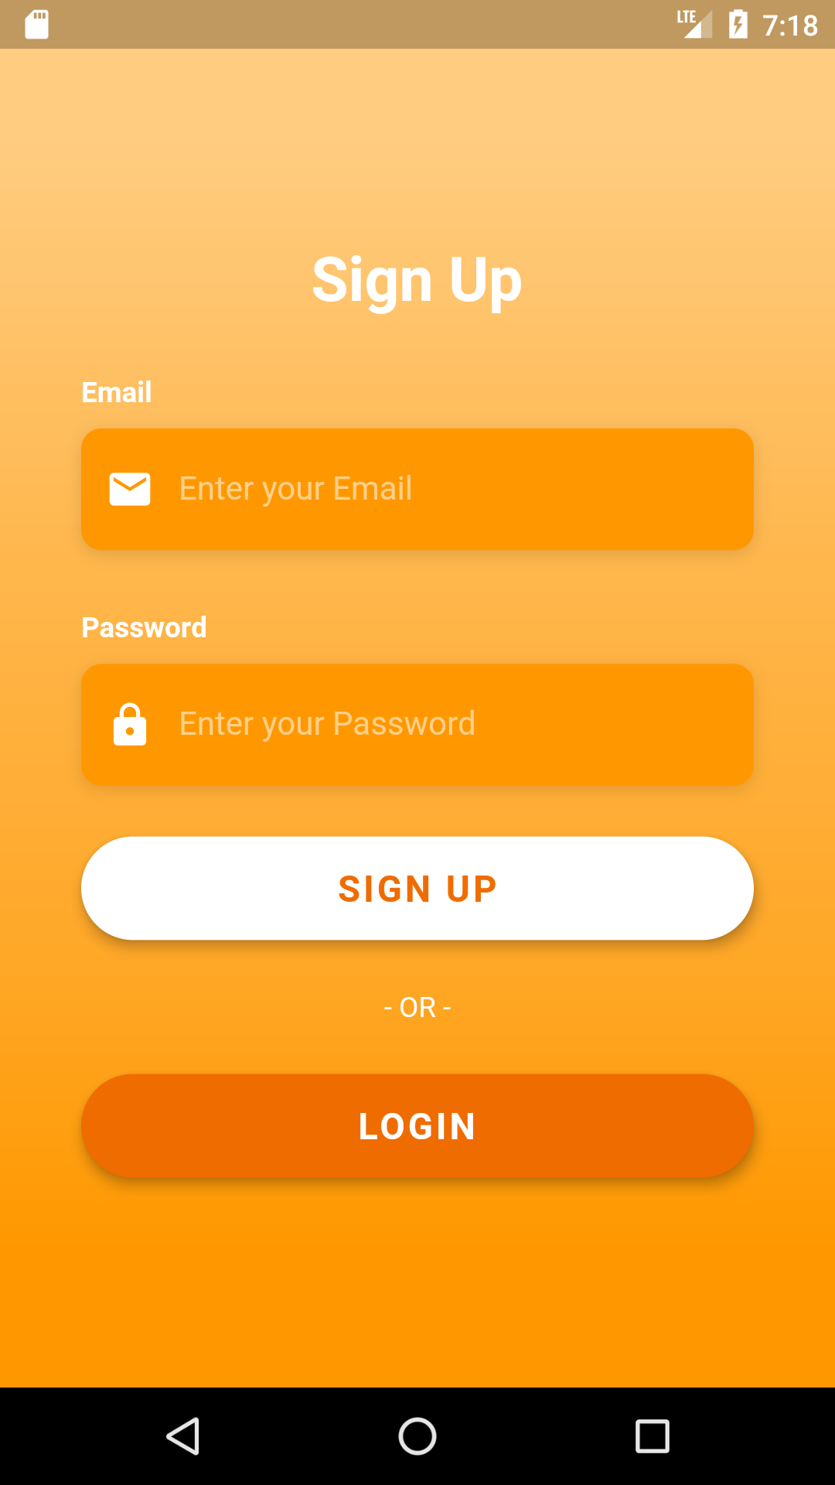
Template for the User Interfaces
Welcome Screen
Login Screen
Sign up Screen
Authentication screens template, consisting of login screen and signup screen, will have a basic form which asks for email and password from the user in order to authenticate the users.

Slide 19
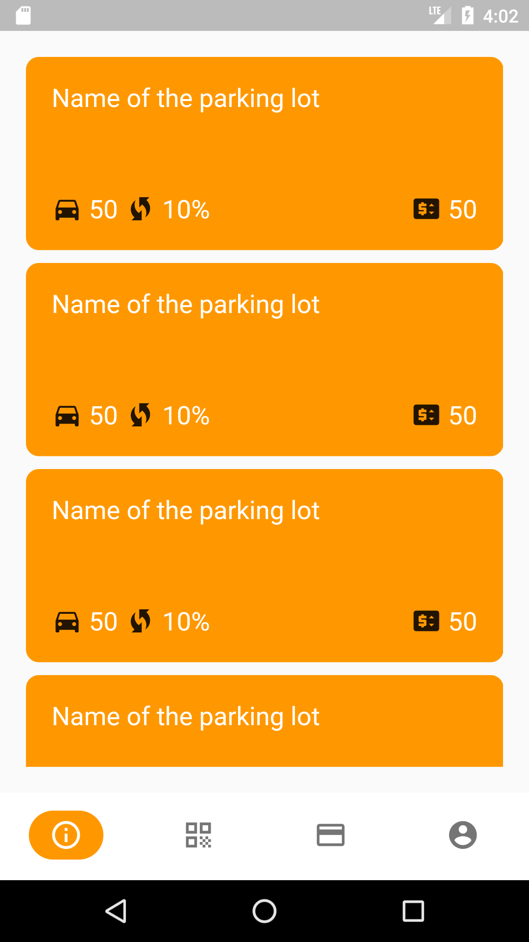
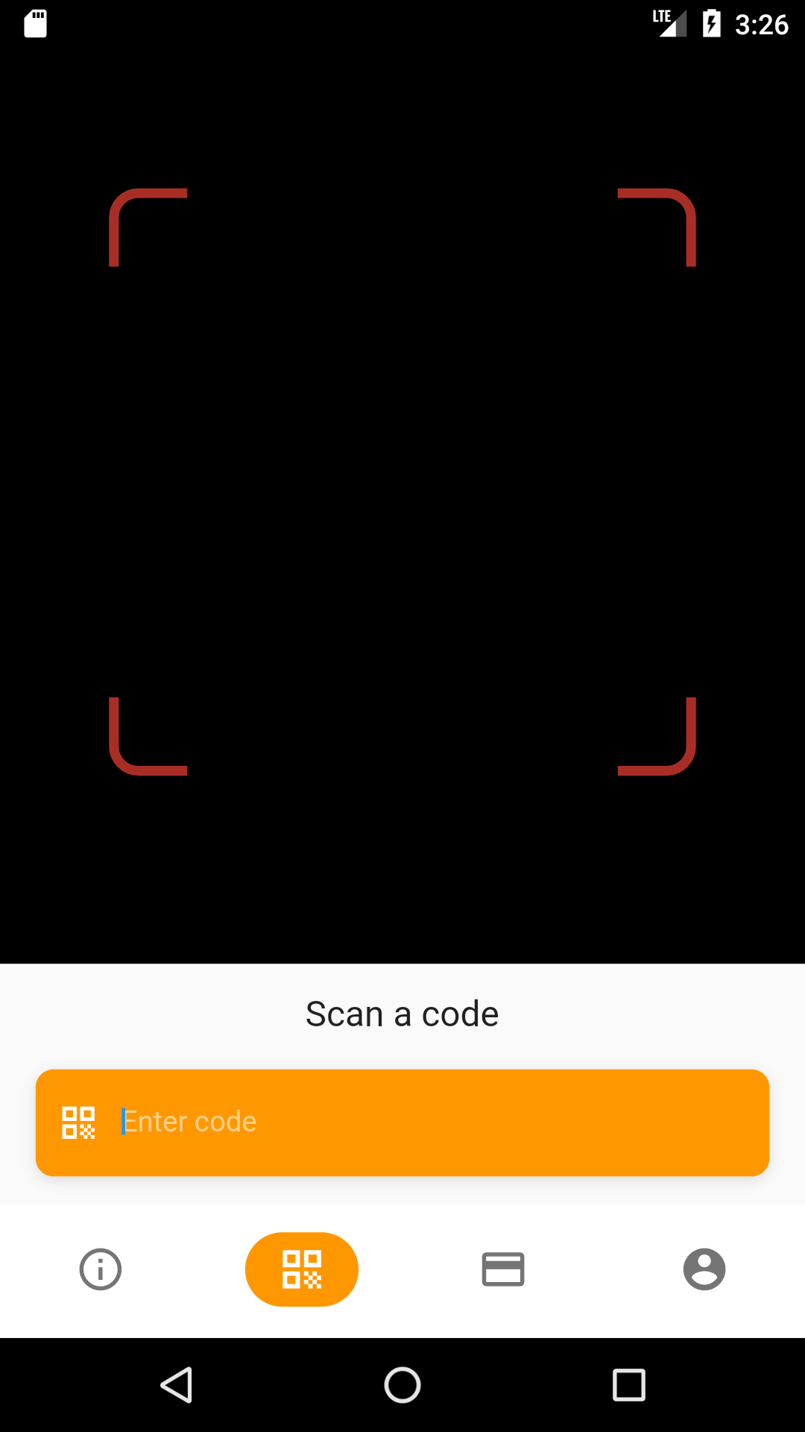
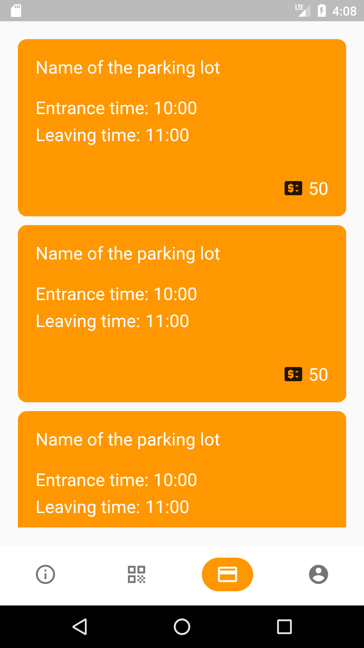
Template for the User Interfaces
Live Density Screen
Qr Code Screen
Payment Details Screen
Available parking lots live screen template will have the box layout which will display the density information of the parking lots.
Check in/out with QR code screen template will have the camera in order to read QR code in the entrances of the parking lots.
Payments details screen will have the box layout which will display the payment details of the customers.
Notes:
The interactive Evaluation method has been used in order to evaluate the user interfaces of the system. I developed the prototype in Flutter and we discussed each screen one by one in order to have what the customer wants.

Slide 20
Programs
04

Slide 21
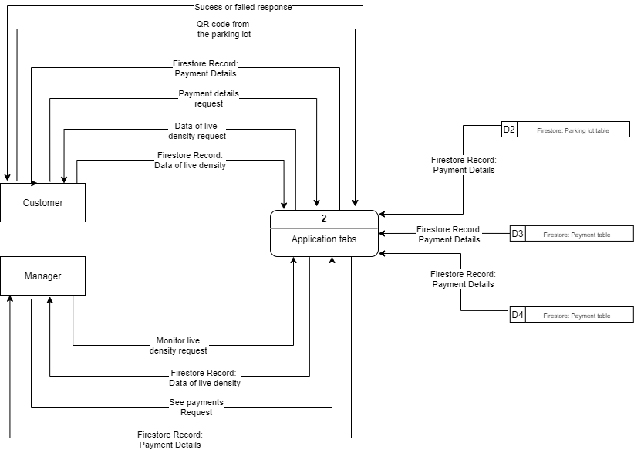
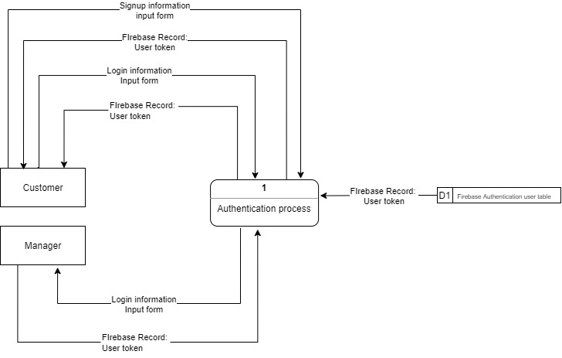
Interface Physical Models

Slide 22
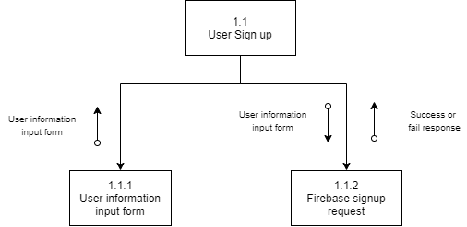
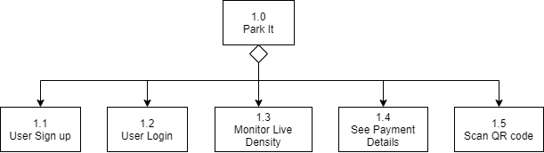
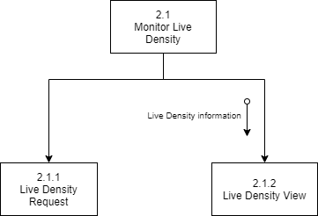
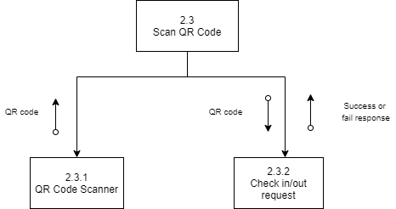
Program Structures

Slide 23
Program Specification
Module Name: userSignUp
Purpose: Sign up new user with user information which are email and password.
Programmer: Ertugrul Sagdic
Due: 14.06.2021
Programming Language: Dart
Events: Sign up user when sign up button is clicked.
Input Name | Type | Provided by
email | string | program 1.1.1
password | string | program 1.1.1
Output Name | Type | Used by | Note
response | boolean | program 1.1.1 | Used to let user know if the process is successful or not
Pseudocode:
get email and password from the sign up input form
call the sign up request function of the firebase with email and password
return response

Slide 24
Databases
05

Slide 25
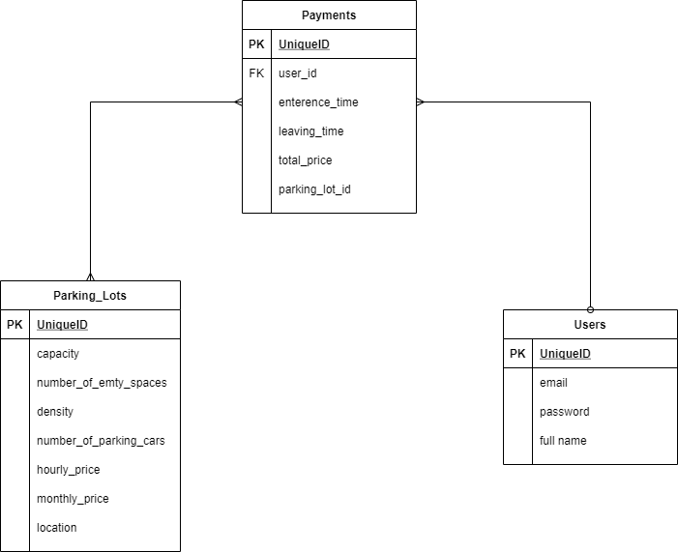
A complete diagram for the physical data model
Notes:
The interactive Evaluation method has been used in order to evaluate the user interfaces of the system. I developed the prototype in Flutter and we discussed each screen one by one in order to have what the customer wants.

Slide 26
A complete diagram for the physical data model
In the data model, we need a Users entity to hold the user information. We will be able to authenticate the user with email and password. Also, There will be a token which is basically a uniqueID of the user. Finally, the user's full name.
In addition, we have a Parking_Lots entity to identify parking lots of the company. We have capacity, number_of_empty_spaces attributes, and number_of_parking_cars to calculate density. With density information, users can monitor the live data. Hourly price and monthly price variables to calculate the payments. Finally the location of the parking lot.
Lastly, the Payments entity is to bill the user. We will show the payment details of the user and all payments for managers.
For the relation between Parking_Lots and Payments, there can be many Payments for many Parking_Lots.
For the relation between Users and Payments, there can be many Payments for a user

Slide 27
Implementation

Slide 28
TABLE OF CONTENTS
01
02
System construction
System installation
03
System maintenance

Slide 29
System construction
01

Slide 30





SYSTEM CONSTRUCTION
Sign up module: This module is created in order to sign the new user to the system.
Login module: This module is created in order to log the user who already signed up to the system.
Monitor live density module: This module is created in order to see the density of the parking lots.
Scan QR code module: This module is created in order to check in/out to the parking lot with QR code.
See payments module: This module is created in order to see the payments history of the customer.
FRAMEWORK PROG. LANGUAGE IDE DATABASE

Slide 31
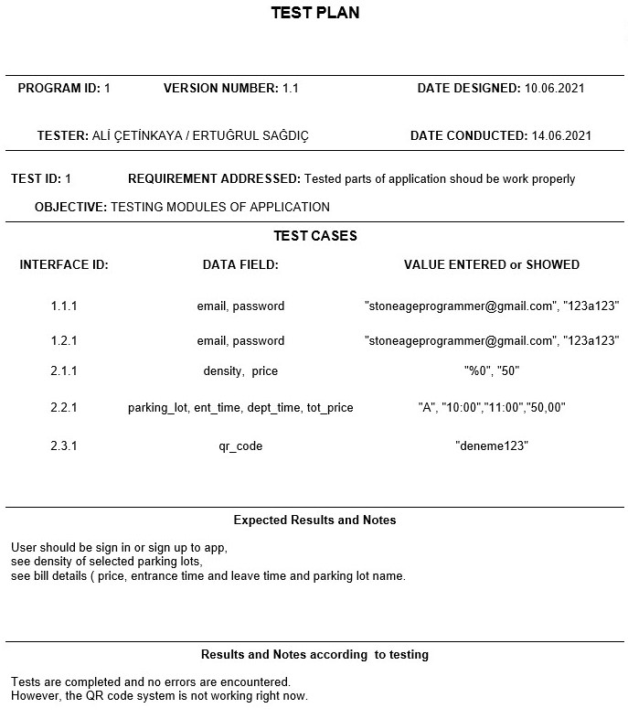

Slide 32
TESTING
UNIT TESTING:
INTEGRATION TESTING:
SYSTEM TESTING:
ACCEPTANCE TESTING:
Black Box Testing
User Interface and Use Scenario, Data Flow and System Interface
Requirements, Usability, Security, Performance and Documentation
Alpha Testing

Slide 33

DOCUMENTATION
SYSTEM DOCUMENTATION:
PROJECT PROPOSAL
SYSTEM REQUEST
FEASIBILITY REPORT
WORK PLAN
SYSTEM PROPOSAL
USER DOCUMENTATION:
USER MANUAL
HELPDESK

Slide 34


STORE AND TRACKING

Slide 35
System installation
02

Slide 36
CONVERSATION STRATEGY/PLAN
i) Style: direct, parallel.
Our conversion strategy will be parallel conversion. The parking lot customers will check in/out with our system and also with the old system until the users will get used to the application.
一 ii) Locations: pilot, phased, simultaneous.
Since the system allows the customers to check in/out to all parking lots, it will be better to apply simultaneous conversion. Since the customers can park in the parking lot with the old system and new system, it will not be a problem to add all parking lots to our system.
一 iii) Modules: whole-system, module by module.
We are going to install the whole system. Of course there are modules in the application. However, in our case, it will be wiser to use the whole system instead of module by module because the modules are dependent on each other at some point. For example we can not see the density of the parking lot without the Scan QR code module which will basically change the information on the database of the specific parking lot.

Slide 37
System maintenance
03

Slide 38
SYSTEM MAINTENANCE
b) Give information about your support plan.
We will make a contract with the customer. According to the contract we will give support 7/24 or less according to the budget of the customer. First year limited support is included in our project.
c) How do you maintain the system? How do you report the problems/bugs?
We are using the Google play store and App store.
In these kinds of mobile application stores, users can easily report the problems and bugs. Also, the report module will be implemented in order to have this kind of report of the problems and bugs in our hand immediately.
d) Do you use support / ticketing system? Explain briefly.
We will implement a report menu inside of the application. Thanks to that feature, users can easily contact us and give feedback about their experiences and problems.
e) How do you handle project assessment and change requests?
We will make a contract with customers about change requests and assessments. According to the contract we will meet change requests and project assessment demands. Also we will provide 1 year limited support and also full support for bugs and problems.

Slide 39
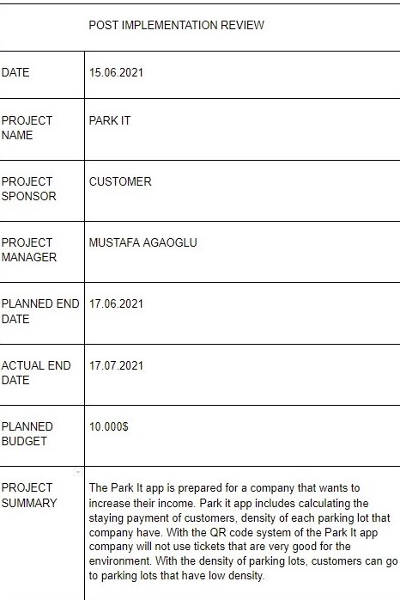

Slide 40
THANK YOU FOR LISTENING!
ANY QUESTIONS?

